Slide 1
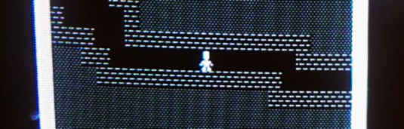

Multiplayer Roguelike for the Commodore 64
Leif Bloomquist Roguelike Celebration 2018
@ GitHub HQ San Francisco USA October 6-7

Slide 2
A bit about me...
Born in Dauphin, Manitoba, Canada
Reside in Toronto, Ontario, Canada
Commodore 64 enthusiast since 1986
Have been dabbling with technology, gaming, and music my entire life
“Day job” in software engineering at MDA, Canada’s leading space company
All my hobby code, tools, notes, and techniques are open-source (MIT)

Slide 3
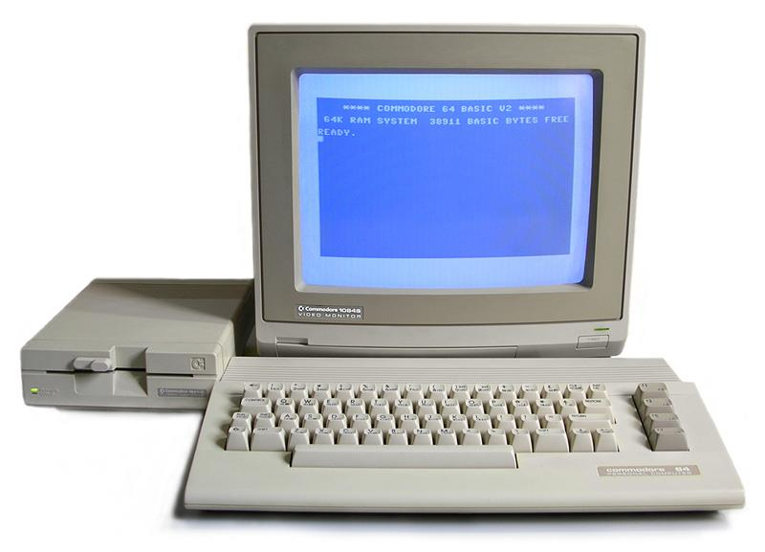
Why the Commodore 64?
Best-selling computer of all time! (Guinness Book of World Records)
~ 17 million units sold
(The Raspberry Pi is poised to overtake it)
Over 25,000 games for the platform
Fun to program on: Bare-metal, machine language, well documented
Very active community in 2018: Gaming, collecting, developing, hardware hacking, modding….

Slide 4
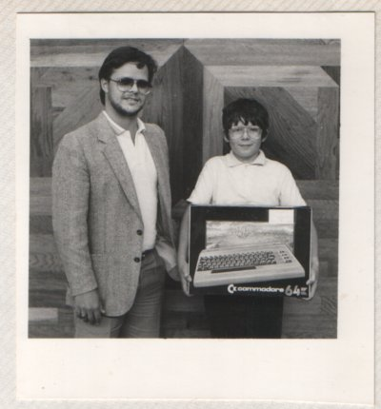
Why the Commodore 64 - My Story
1986

Slide 5
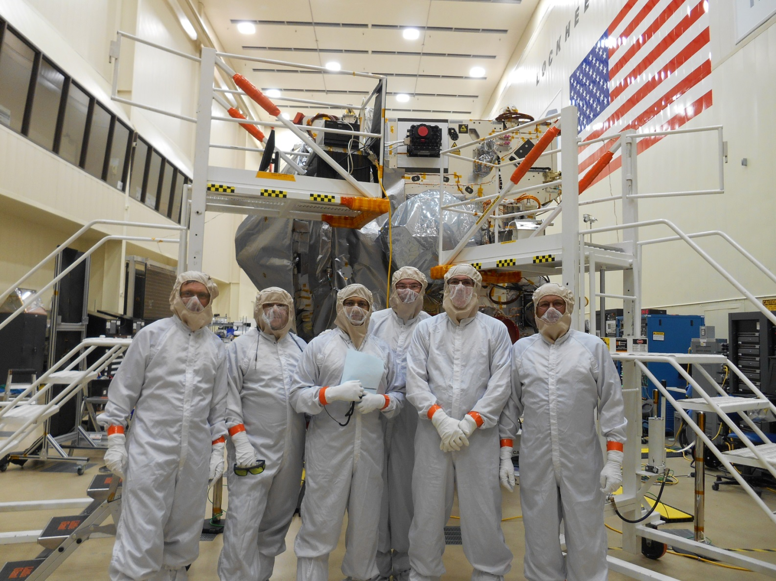
Why the Commodore 64 - My Story
2016

Slide 6
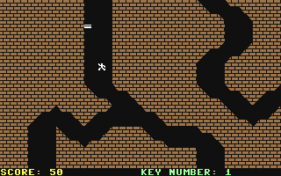
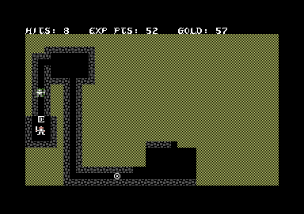
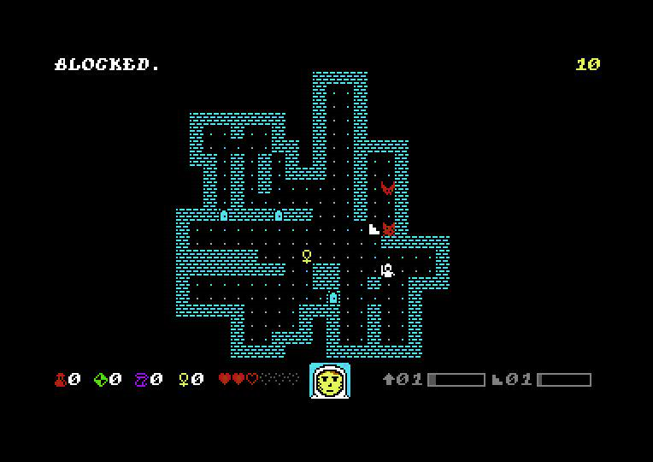
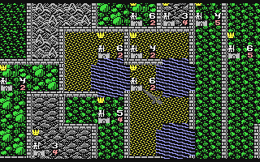
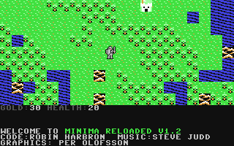
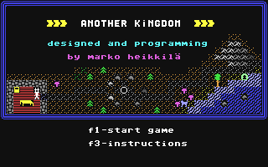
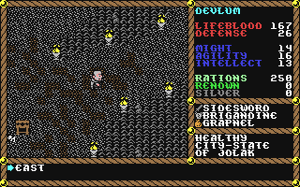
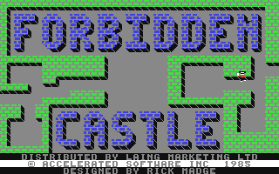
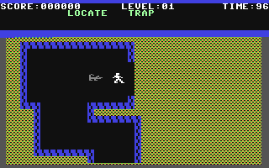
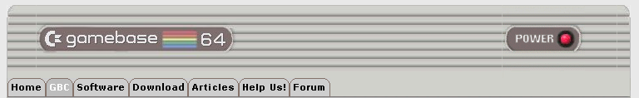
Roguelikes on the Commodore 64
The Commodore 64 was known for its impressive game catalogue
Gamebase64.com lists 25,700 known games!
More than 200 are “Roguelikes” or variations (Adventure 2D, RPG 2D, etc)

Slide 7
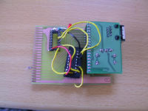
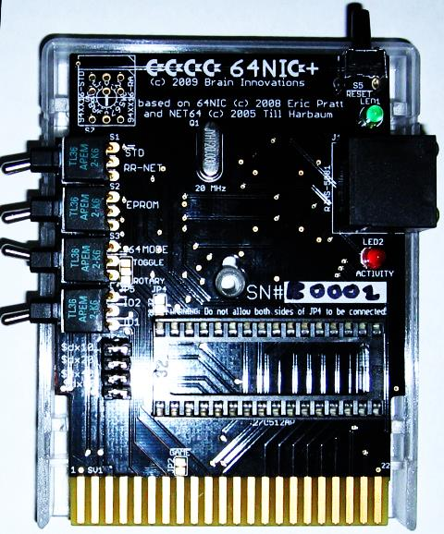
Networking on the Commodore 64?
A miracle occurred in 2002!
Adam Dunkels unveils “The Final Ethernet” – a prototype 10BaseT Ethernet “cartridge” for the Commodore 64 based on the Crystal Semiconductor CS8900 chip
Dunkels also releases the Contiki Operating System with numerous network demo apps, all open-source
Commercial+homebrew versions appear: RR-Net, FB-Net, 64NIC+, ETH64…
Plenty of tools – file transfer, terminals, chat, cross-development, web browsers, etc.
Where are the games?
Photo Credits: Adam Dunkels and RETRO Innovations

Slide 8
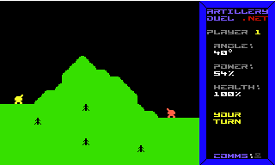
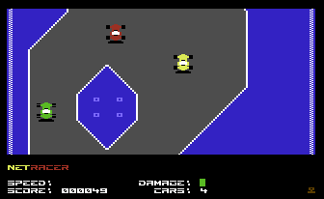
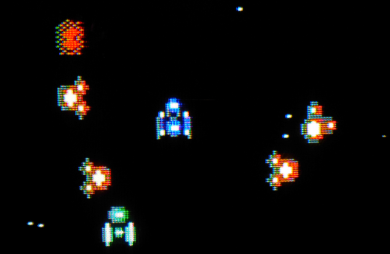
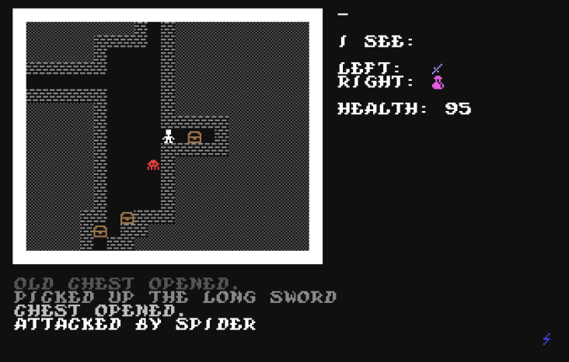
Evolution of C64 Multiplayer Games
Artillery Duel Network (2007)
Two players
Peer-to-Peer
Turn-based
NetRacer (2008)
Introduced a server
Static game world
Maximum 8 players
Real-time
Vortex (2014)
Introduced server-controlled enemies
Dynamic game world (in work)
Massive game world (10,000 screens)
Unlimited players
Real-time
This Game (2018)
Server-controlled enemies
Dynamic, interactive game world
Added third dimension (depth)
Object persistence
Unlimited players
Real-time
Source code for all of these is available on GitHub – use them as a basis for your own games!

Slide 9
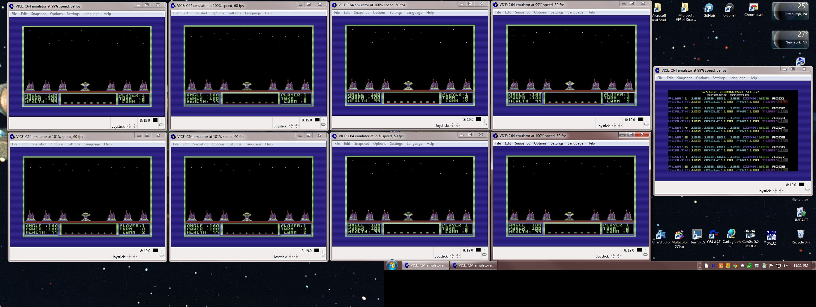
Evolution of C64 Multiplayer Games
Space Command by Dan “Ragooman” Ragonti and Jefferey “arkaxow” Brace
Eight-Player Simultaneous real-time “Artillery Duel”-type game, with C64 server!

Slide 10
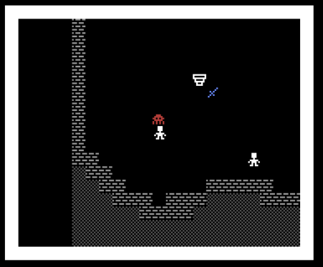
Next Challenge: A RogueLike
What if…the other characters in the dungeon were other players that you could…
Interact with?
Go on quests together with?
Team up with against monsters?
Work together to solve puzzles with?
Leave each other tools, clues, share equipment?
That would be cool!

Slide 11
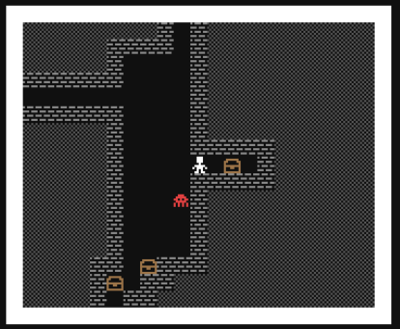
A `RogueLike` ?
Real-time (not turn-based)
One single, shared instance
Multiplayer
Object persistence
Monster persistence (with respawn)
“Multi-User Dungeon”

Slide 12
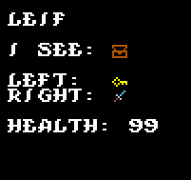
Unique? Gameplay Mechanics
Carry items in Left hand and/or Right Hand
Explicit Attack commmand
Double up swords or shields, or one of each
Other items to be carried: Potions, Keys, Gold, etc
No “inventory” (to encourage multiplayer)
Magic items that recharge and return to origin when used
Use or inspect items
Play with Joystick on C64!
Voice chat though Discord
...more secrets to discover!

Slide 13
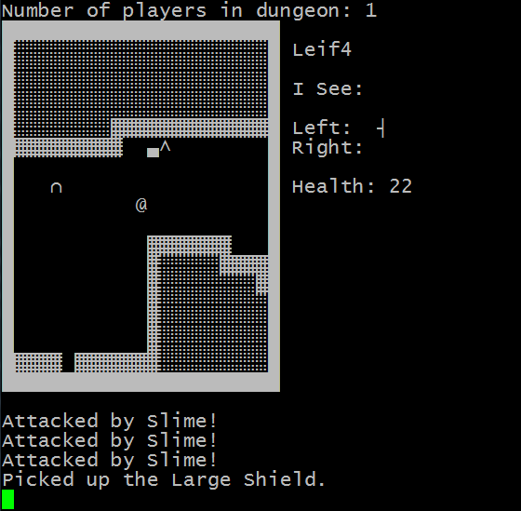
Multiple Clients!
Partially Implemented:
Commodore 64
JavaScript (Browser)
Telnet
VT100/DEC Terminals
Future:
Tandy CoCo?
Apple II?
VIC 20?
Atari?
More?

Slide 14
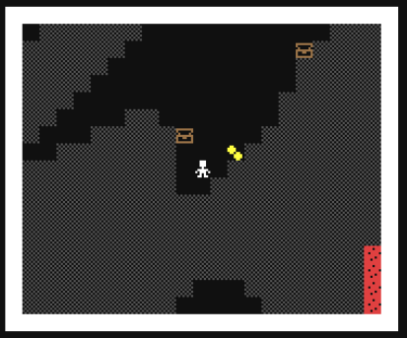
Implementation Details
Server: Java 8
C64 Client: 6502 assembler (ca65 cross-assembler)
IP65 network stack – RR-Net, 64NIC+
UDP with simple ACKs
Networking:
Screen streamed to clients on change, or @ 1 Hz

Slide 15
Model-View-Controller Architecture
Model
- Data structure with all maps, object, and entity locations
- Logic for what actions are allowed
View
Controller
Representation of immediate area
Entity Actions
(Players, Monsters )
Translations
(PETSCII, ASCII, ANSI, UTF-8, etc.)
Server
AI
Players
Socket
Interface
(TCP/UDP)

Slide 16
Monster Behaviours: Finite State Machine
Wandering
Idle
Chasing
Retreating
Attacking
Tweaking the state transition conditions gives the monsters different behaviours and “personalities”

Slide 17
Game Levels
Mix of hand-edited and procedurally generated
Initial target is 10 levels, 1000 x 1000 tiles each (or more)
Demo server is 4 levels, 100 x 100 tiles each

Slide 18
Demo Server!
Web: http://rogue.jammingsignal.com/rogue/
Telnet: rogue.jammingsignal.com port 3006
C64: PRG file
The game is winnable: What is the magic word?

Slide 19
// TODO
The game still needs a name!
Different character types
Ranged weapons
A* search for monster movement
Vision algorithms/raytracing
Still many gameplay details to be worked out

Slide 20
Want to Help?
Puzzle designers
Monster behaviours
Coders
Login system
Pixel artists
Level designers
Playtesters
Other clients
Gameplay
Balancing
…the game still needs a name!
Open Source – (MIT License)! On GitHub of course: ☺
https://github.com/LeifBloomquist/MultiRogueLike

Slide 21
Thank You!
Networking code: Per Olofsson, Jonno Downes
Playtesting: Andreas Bloomquist and Tiffany Antopolski
Graphics: “q0w/Atlantis”
Advice and motivation: Robin Harbron
/r/roguelikedev community on Reddit

Slide 22
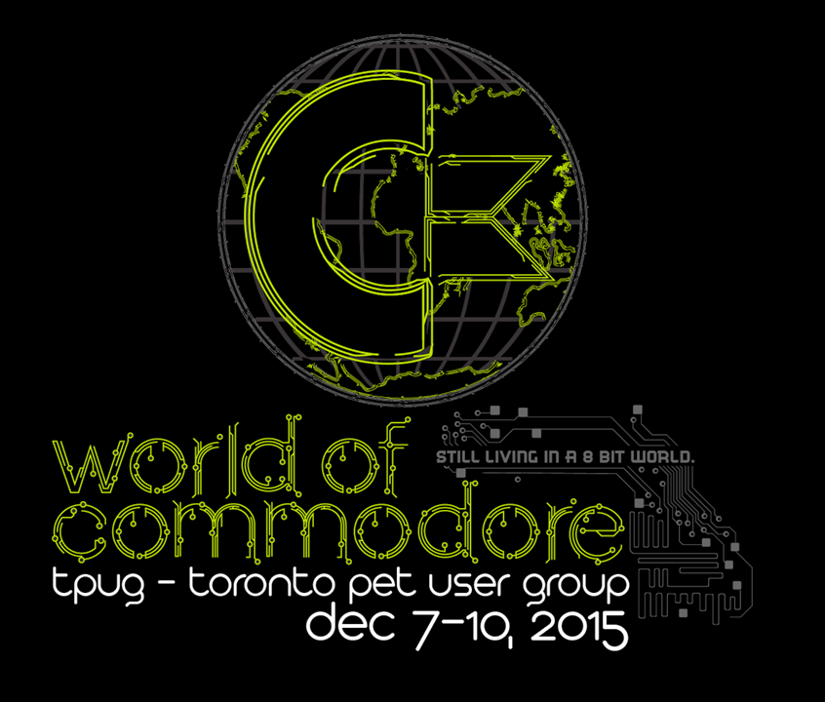
Toronto, Ontario Canada December 1-2, 2018
www.worldofcommodore.ca

Slide 23




Contact Info
www.jammingsignal.com (blog)
www.facebook.com/LeifBloomquist
@schemafactor
leif@schemafactor.com

